Slide 1
Soil Biology
Joao Carlos De Moraes Sa
Notes:
Only change the name, date, and location.

Slide 2
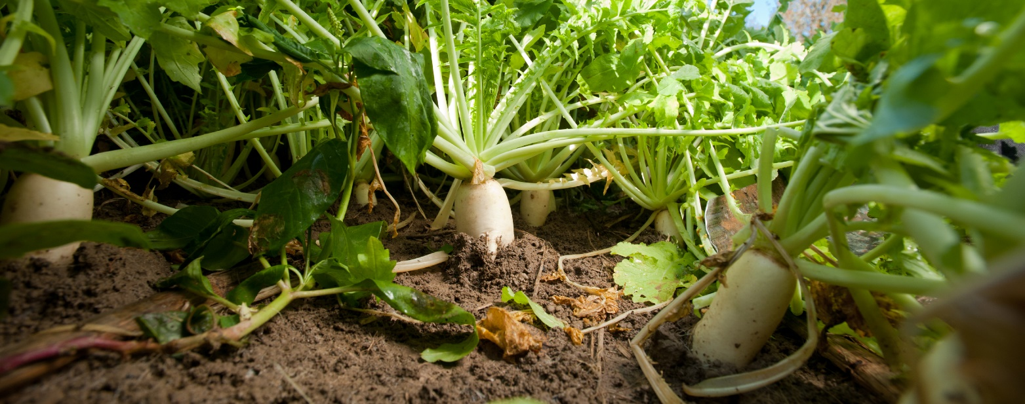
Objectives
List one key activity performed by each of the three functional groups for soil organisms
List two soil organisms that represent each functional group
Describe biological hotspots & how they relate to key ecosystem functions
Remsberg, SARE
Notes:
These are directly tied to the worksheet, therefore they must be covered and not changed

Slide 3
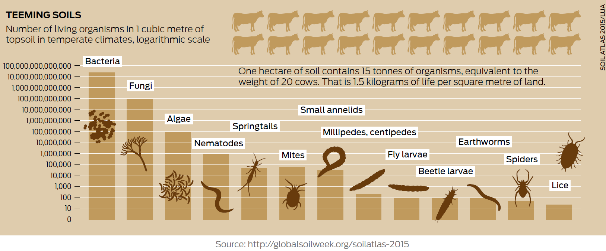
Soils Host Vast Numbers, Mass, and Diversity of Organisms
1.3 yd³
2.5 acres
Notes:
Slide 4 and 5 can be swapped around according to your preference (make font red)
Source: Global soil biodiversity atlas 20 cows per acre. 3 lbs per sq yrd of soil
1 acre healthy soil harbors 27,000 lb. of biomass:
10,000 lb. fungi; 6000-10,000 lb. bacteria
2700 lb. algae
1800 lb. earthworms
600 lb. protozoa/nematodes
Soils host ~25% of Earth’s Biodiversity
>90% have not been cultured or fully identified
Plant-microbe-animal interactions involved in all soil processes & functions

Slide 4
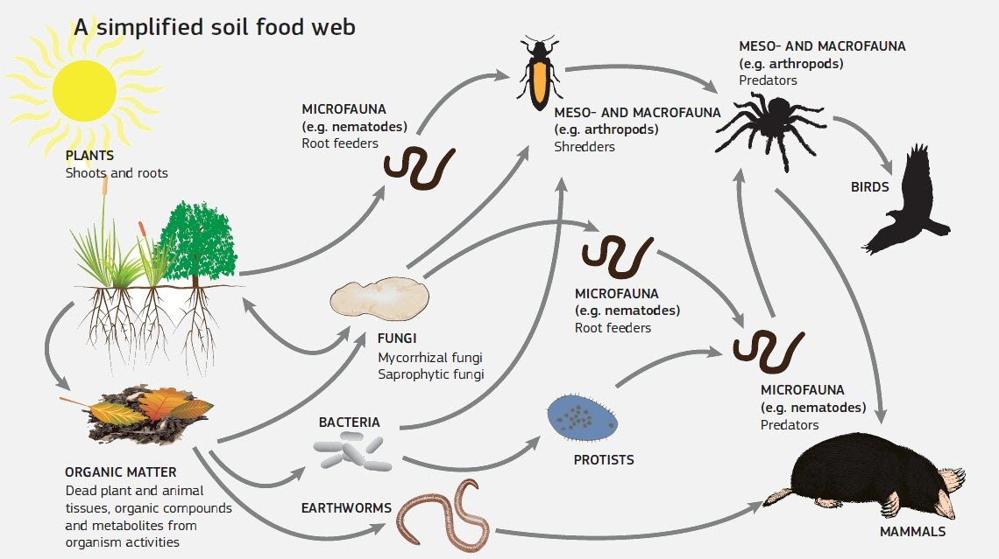
Bacterial and Fungal feeder
Global Soil Biodiversity Atlas. 2016. Orgiazzi, Bardgett, Barrios et al. Luxembourg, European Commission, Publications Office of the European Union: 176p.
Notes:
Historically, soil biodiversity was studied by mapping the soil food webs. This approach details the chain of energy transfer in soil and is based on grouping organisms according to their trophic role and food preferences. In a very simplistic manner, the food web is fueled by plants and photosynthetic bacteria that fix C from the atmosphere through photosynthesis. Other organisms then obtain their energy by breaking down plant residues and organic compounds or by consuming other organism. During decomposition and consumption, nutrients are converted from organic to inorganic forms and made available to plants and other soil organisms (Paraphrased from Turbe et al., 2010).
Pros of the food web approach: Very useful for understanding nutrient cycling and energy flows and provided the foundation to study functional soil biodiversity.
Cons of the Food web approach: does not illustrate the mass and numbers of soil biology.
Limitations: overlooks other important processes not based on feeding relationships, such as soil structure development, parasitism and pathogenesis. Relies on biomass and species composition, whereas activity provides a better understanding of soil biological function.

Slide 5
Soil Organisms
3 Functional Groups
Key Ecosystem Functions
Decomposition & C Cycling
Ecosystem Resiliency
Ecosystem Engineers
Building soil, creating aggregates & pores
Biological Regulators
Population Regulation
Nutrient Cycling
Chemical Engineers
Plant Productivity
Turbe et al., 2010;
Global Soil Biodiversity Atlas. 2016. Orgiazzi, Bardgett, Barrios et al.
Notes:
The soil biological community controls all soil processes and functions important for plant productivity and multiple ecosystem services.
Soil organisms have coevolved for hundreds of millions of years and interact in positive (mutualistic) and negative (e.g. predator versus prey) ways. Conserving biodiversity also translates to conservation of important functions or services that the biological community provides. Keeping in mind that soil, soil biodiversity, and soil functions are complex interactions between inherent soil properties, climate, management, and the life within the soil, a simplistic view is to categorize soil organisms into the following broad functional groups. These include the soil ecosystem engineers, the biological regulators, and the chemical engineers (aka microbial decomposers).
The arrows crossing among and between the different groups are an indication that the groups are not exclusive to certain members and multiple members can be influential on other functions but in order to follow some structure and help us understand key groups, we will go through them by identifying the dominant players.
There are a number of functions that are documented by many papers that are much more complex, this paper lends a more elementary version of the complexiity. You can delve deeper into these functional groups and how and what they do on a more complex level
The Microbial populations are important to producers because they improve soil function, water infiltration, storage, yield- feed fiber food, improve porosity, help decrease compaction, cycle nutrients.
The following slides will explain:
what these groups are primarily responsible for,
key representatives will be identified and a brief overview of specific functions,
where they are found in soils, and their abundance will be provided.
Anne Turbé, Arianna de Toni, Patricia Benito, Patrick Lavelle, Perrine Lavelle, et al.. Soil biodiversity: functions, threats and tools for policy makers. 2010. ffbioemco-00560420
European Commission, Joint Research Centre, Johnson, N., Scheu, S., Ramirez, K. et al., Global soil biodiversity atlas, Johnson, N.(editor), Scheu, S.(editor), Ramirez, K.(editor), Lemanceau, P.(editor), Eggleton, P.(editor), Jones, A.(editor), Moreira, F.(editor), Barrios, E.(editor), De Deyn, G.(editor), Briones, M.(editor), Kaneko, N.(editor), Kandeler, E.(editor), Wall, D.(editor), Six, J.(editor), Fierer, N.(editor), Jeffery, S.(editor), Lavelle, P.(editor), Putten, W.(editor), Singh, B.(editor), Miko, L.(editor), Hedlund, K.(editor), Orgiazzi, A.(editor), Chotte, J.(editor), Bardgett, R.(editor), Behan-Pelletier, V.(editor), Fraser, T.(editor), Montanarella, L.(editor), Publications Office, 2016, https://data.europa.eu/doi/10.2788/2613

Slide 6
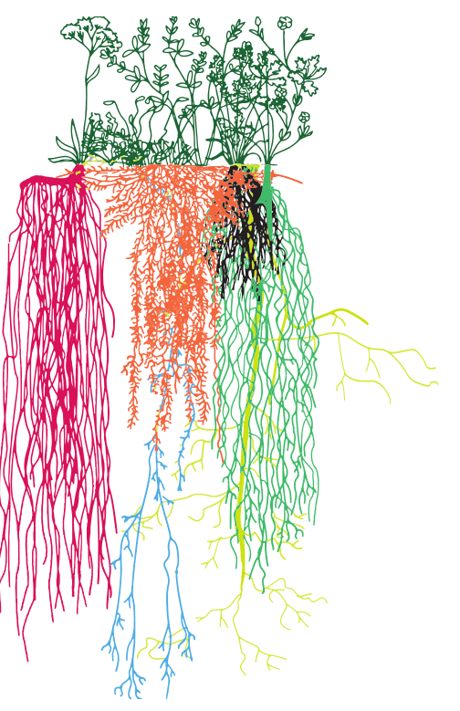
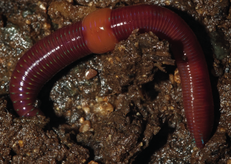
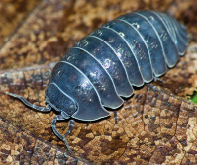
Ecosystem Engineers
Functional group | Function | Representative members
Ecosystem Engineers | Build pore networks, aggregates, soil mixing | Plant roots, earthworms, larger invertebrates (e.g., millipedes, centipedes, beetles)
Modified from Turbe et al., 2010; Images from: Orgiazzi, Bardgett, Barrios et al. 2016. Global Soil Biodiversity Atlas.
Notes:
Reference Back to the demos of the good soil to explain these in the soil samples compare and contrast
Source: Turbe et al., 2010
Ecosystem engineers are the larger organisms such as earthworms, ants, termites, etc. as well as plant roots that modify or create their own habitat and in doing so create biopores that channel air and water, mix organic materials during burrowing, and help build resistant soil aggregates. By regulating resources and redistributing and regulating access to resources, these organisms create ‘hotspots’ that support high numbers of microorganisms.
A large source that fuels the entire soil system, are the impacts of plant roots, which is the first group of ecosystem engineers to discuss.
Plant roots can cause physical weathering as they grow and expand inside cracks in the rocks. Roots and decaying vegetation also produce organic compounds such as solvents, acids and alkalines that enhance the actions of percolating rainwater.
The two main types of root systems are fibrous and taproot. Fibrous roots are the traditional structures formed by primary and secondary roots branching in all directions in the soil. By contrast, taproots are characterized by a single firm root growing straight down, with minor roots developing either side of it. Other specialized roots do exist; for example, the tuberousroots of sweet potato are modified for the storage of nutrients
and water.
The number of known plant species has been estimated to be around 400 000.
Ecosystem engineers redistribute soil particles, micobes, and organic matter

Slide 7
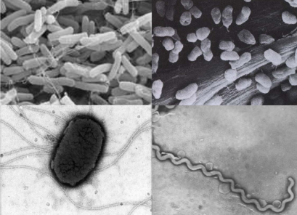
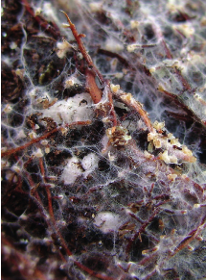
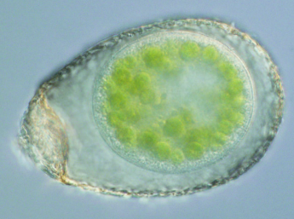
Chemical Engineers
Functional group | Function | Representative members
Chemical Engineers | Regulate 90% of energy flow in soil; Build soil organic matter & aggregates | Soil microbes (bacteria i.e. rhizobia, fungi, protozoa, roots)
Modified from Turbe et al., 2010; Images from: Orgiazzi, Bardgett, Barrios et al. 2016. Global Soil Biodiversity Atlas.
Notes:
Source: Turbe et al., 2010
The three groups include:
Chemical Engineers (processors) which involve soil microbes, regulate 90% of energy flow which is directly tied to nutrient cycling which includes macro and micro nutrients, in soil and are responsible for decomposition of plant organic matter into nutrients that are available for plants. Soil microbes are also responsible for stimulating plant growth, plant protection and the production of multiple antibiotics used for human and animal health. All nutrients must be processed by microbes to be plant available.
See the Resources section to determine how they impact energy flow. In Turbe et al 2010 it is explained very well.

Slide 8
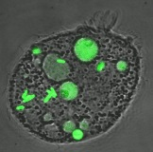
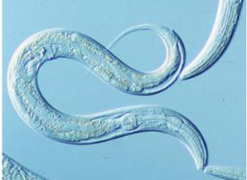
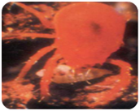
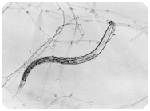
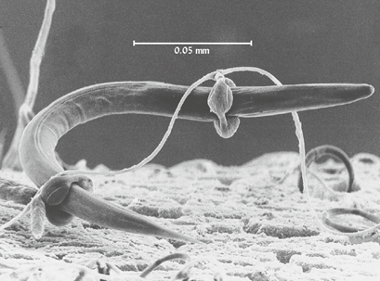
Biological Regulators
Functional group | Function | Representative members
Biological Regulators | Regulate populations of other soil organisms | Protozoa, nematodes, and other small invertebrates (e.g., springtails, mites but also microbes)
Modified from Turbe et al., 2010; Images from: Orgiazzi, Bardgett, Barrios et al. 2016. Global Soil Biodiversity Atlas.
Notes:
Source: Turbe et al., 2010
Biological regulators include small invertebrates such as protozoa, nematodes, pot worms, springtails, and mites Through grazing, predation or parasitism, these organisms regulate populations other invertebrates and microbes

Slide 9
Knowledge check – poll question
Which soil organism functional group is responsible and regulates 90% of the energy flow in soil?
Notes:
Answer is chemical engineers

Slide 10
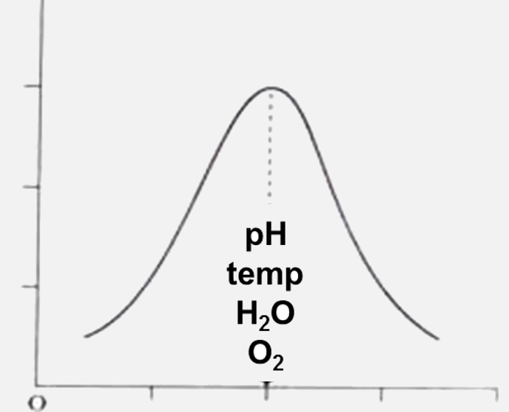

Optimal Activity in Most Ag Systems Occurs When Conditions are ‘Just Right’
> 90% bacteria in soil are inactive!
Near neutral pH
Moderate temps
Moist conditions
Aerated
Abundant food (C)
Adapted from Turbe et al. 2010
Notes:
There are numerous factors that influence biodiversity and activity of soil organisms. Although microbes can exist in the most extreme environments possible, most agricultural soils benefit from the following conditions:
Near-neutral pH (6-7.5); Warm soil temps (60-90°F)
Soil water at field capacity; Good aeration (low bulk density)
Abundant and diverse food sources; Diverse soil pore sizes
Minimal contaminants, salts
Equate it to the goldilocks
Paraphrased from Turbe et al., 2010
The majority of life in soil is not in an active state but often remain in a resting stage that allows them to stay alive when conditions are not conducive but rebound quickly when conditions improve.
For example, over 90% bacteria in soil are inactive because they have not been able to move towards an organic substrate to use but spring to life quickly upon rewetting of soil to redistribute soluble organic C and nutrients.
If we want to encourage a diverse and healthy habitat for microorganisms we must provide food, nutrients, proper aeration, pH, water, etc.
Survival Strategies:
‘crytobiosis’ = suspended metabolism to survive extreme temperatures or dryness
Protists and nematodes form cysts
Bacteria form endospores
Fungi form spores
Bacteria and fungi change cell chemistry
Microarthropods can enter a state of ‘crytobiosis’
Photo: The Story of Goldilocks and the Three Bears. Read Along With Me Paperback – January 1, 1962
by No Author (Author) Publisher Samual Lowe Co. Kenosha, WI.

Slide 11
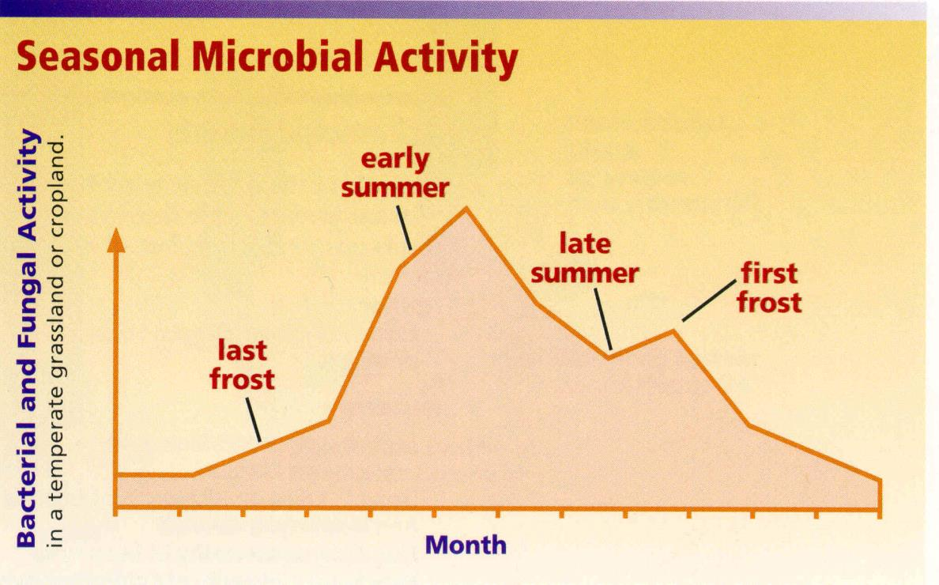
Seasonal Microbial Activity
Microbes are impacted by temp and moisture
Ingham et al. 2000
Notes:
Greatest activity in temperate systems occurs in late spring and early summer when temperature and moisture are optimal for growth
Not all organisms are active at a particular time, some remain dormant only to become active later in the season, this results benefits being stretched out over time
(ENGAGE CLASS) Talk through why activity is like this. Look at timeline in months, think about plants growing releasing root exudates,
File name: A-7, 250KB (also Season.jpg at 1917K)
Image courtesy of SWCS Soil biology primer
Ingham, E.R., Moldenke, A.R., and Edwards, C.A. 2000. Soil Biology Primer. Soil & Water Conserv. Soc’y, Ankeny, IA.

Slide 12
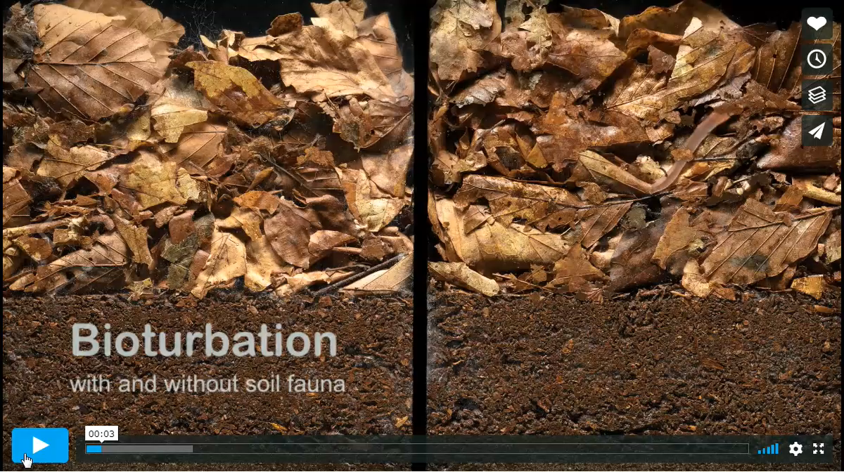
Soil Fauna Breakdown Biomass
15 week time lapse
Without soil fauna (only microbes)
With soil fauna and microbes
Made by: Wim van Egmond
https://vimeo.com/222168889
Notes:
“Bioturbation is the mixing of (plant) residues into soils and sediments by biotic activity. It is one of the fundamental processes in ecology, as it stimulates decomposition, creates habitats for other (micro)fauna and increases gas- and water flow through the soil.
Here you can see a system without (left) and with (right) ASK Participants!!! What do you see on the right vs. The left? soil fauna such as earthworms, potworms, collembola, mites and isopods over a 15 weeks period.
Point out shredders increasing biomass contact with the soil microbiome
Point out the porosity on the right vs. The left
As this biomass is broken down it's nutrients are being release processed into the soil biology and cycled back to plants as a plant available nutrient. Over time this can help reduce inputs.
During this period, whereas only small fungal activity can be seen on the left side, the layer of leaves on the right side is almost completely incorporated in the soil due to the interaction between microbes, microfauna and mesofauna.
This video is part of the Soil Life in Action project. The movie can be used for education. For other use please contact us.”

Slide 13

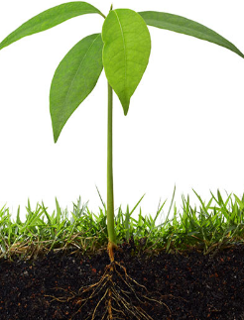
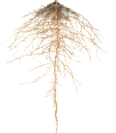




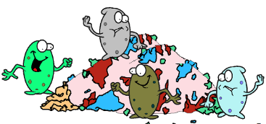


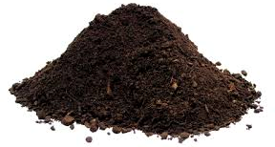
Continuous Flow of C Drives System
Atmospheric CO₂
Respiration CO₂
“Active” organic matter C
Plant C
SOM–C
Dead microbes
Mineral Associated Organic Matter
Image courtesy of Dr. Chenhui Li
Notes:
The flow of active organic matter (organic C) is driving force of the microbial biomass and their activities
Note: the reason it takes so long for organic matter to accumulate in the soil from crop residue, cover crops and manure on the surface is due in part to microbial respiration – most returned to atmosphere as CO2. Photosynthesis and plant root exudates are now recognized as constituting the primary pathway for soil building!
Key Points:
Microbial Carbon Pump: Photosynthesis and plant root exudates are now recognized as constituting the primary pathway for soil building. They are the predominate source of carbon that drives the system. That breakdown at the litter layer by macrofauna and plant root exudates contribute the “active” organic matter or labile carbon.
As this carbon is further broken down and the process of feed, breeding and dying occurs it gets tied up in the microbial biomass. That turn over of dead microbes contributes directly to the humic component of soil organic matter carbon. It must be captured and contained in and among aggregate surfaces, so therefore it has the propensity to make up around 30% of SOC in the soil. We need good strong aggregates that follow the principles to keep this from being subject to loss.
As Referenced in these Papers:
Anthony, Mark, A., Thomas W. Crowther, Daniel S. Maynard, Johan van den Hoogen, Colin Averill. 2020. Distinct Assembly Processes and Microbial Communities Constrain Soil Organic Carbon Formation. One Earth. Volume 2, Issue 4,Pages 349-360. ISSN 2590-3322, https://doi.org/10.1016/j.oneear.2020.03.006.
Liang, C, Amelung, W, Lehmann, J, Kästner, M. 2019. Quantitative assessment of microbial necromass contribution to soil organic matter. Glob Change Biol. 25: 3578– 3590. https://doi.org/10.1111/gcb.14781
Sokol, N.W., Bradford, M.A. 2019. Microbial formation of stable soil carbon is more efficient from belowground than aboveground input. Nature Geosci 12, 46–53. https://doi.org/10.1038/s41561-018-0258-6
Sokol, NW, Sanderman, J, Bradford, MA. 2019. Pathways of mineral‐associated soil organic matter formation: Integrating the role of plant carbon source, chemistry, and point of entry. Glob Change Biol. ; 25: 12– 24. https://doi.org/10.1111/gcb.14482
Sokol, N.W., Kuebbing, S.E., Karlsen‐Ayala, E. and Bradford, M.A. 2019. Evidence for the primacy of living root inputs, not root or shoot litter, in forming soil organic carbon. New Phytol, 221: 233-246. https://doi.org/10.1111/nph.15361

Slide 14
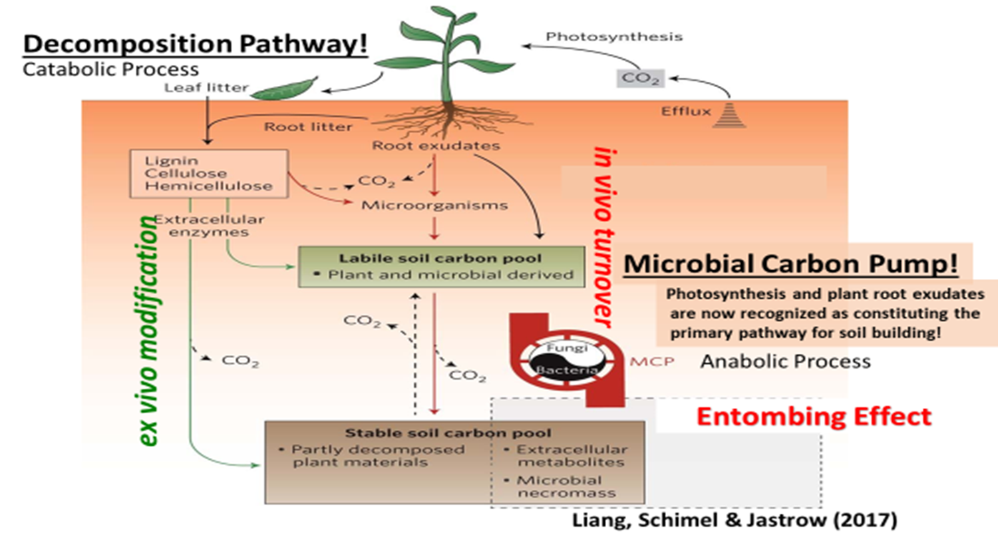
Building Soil Organic Matter and Creating Aggregates
Microbial Metabolic Processes Involved in Carbon Cycling
MAOM
MAOC
Notes:
Can be used instead of slide 13 depends on comfort level. Paper supporting is in the resources folder
Photosynthesis and plant root exudates are now recognized as constituting the primary pathway for soil building!
Organic Matter is created at depth in the soil where microbial carbon pump is occurring with Mycorrhizal Fungi/Associative Bacteria – you have to have biologically fixed Nitrogen in order to create humic substances in the soil (Soil Organic Matter).
Plant root inputs build soil carbon 5 times faster than carbon derived from above-ground biomass.
Whether you produce grain, milk, beef. Lamb, wool, cotton, sugar, nuts, fruit, vegetables, flowers, hay, silage or timber ----
You are first and foremost a
“LIGHT FARMER”
TWO RULES FOR “LIGHT FARMING”!
Build photosynthetic capacity- how much green leaf capacity do you have? You can’t have fallow thinking to store water? Bad practice!
Enhance photosynthetic rate – Accelerate Building Organic Matter!

Slide 15
Organic Matter Pools
Soil Organic Matter
Labile Organic Matter
Rapid Turnover
*Long Term Carbon
Protected or Slow Turnover C
Biomass
Living Organisms
Detritus
Free Identifiable dead plant material
Particulate OM
Free partially degraded plant material
Free or dissolved biomolecules, degradation products
Particulate OM
Protected bits of plant mat. & microbial cell walls, aromatic rich Alkaline extracts
Protected Mineral Associated Organic Matter (MAOM) Dead biomass
Char Black aromatic products of fire
*Protected on clay surfaces, soil aggregates and in ultra-micropores
Adapted from: The Nature and Properties of Soils 15th Edition- Weil and Brady and Sokol et al. 2022 and Camenzind et al. 2023
Notes:
This diagram illustrates the many pools and fractions of soil organic matter
Soil organic matter is the dominant carbon pool in terrestrial ecosystems, and its management is of increasing policy relevance. Soil microbes are the main drivers of soil organic carbon sequestration, especially through accumulation of their necromass. However, since the direct characterization of microbial necromass in soil is challenging, its composition and formation remain unresolved. Here we provide evidence that microbial death pathways (the distinct processes of microbial dying) in soil affect necromass composition and its subsequent fate. Importantly, the composition of derived microbial necromass does not equal that of microbial biomass. From biomass to necromass, distinct chemical transformations lead to increases in cell wall/cytoplasm ratios while nutrient contents and easily degradable compounds are depleted. The exact changes depend on environmental conditions and the relevance of different microbial death pathways, for example, predation, starvation or anthropogenic stresses. This has far-reaching consequences for mechanisms underpinning biogeochemical processes: (1) the quantity and persistence of microbial necromass is governed by microbial death pathways, not only the initial biomass composition; (2) efficient recycling of nutrients within microbial biomass presents a possible pathway of organic carbon sequestration that minimizes nitrogen losses; (3) human-induced disturbances affect the causes of microbial death and consequently necromass composition. Thus, new research focusing on microbial death pathways holds great potential to improve management strategies for soil organic carbon storage. Not only microbial growth but also death drive the soil microbial carbon pump.
Sokol, N.W., Slessarev, E., Marschmann, G.L. et al. Life and death in the soil microbiome: how ecological processes influence biogeochemistry. Nat Rev Microbiol 20, 415–430 (2022). https://doi.org/10.1038/s41579-022-00695-z
Camenzind, T., Mason-Jones, K., Mansour, I. et al. Formation of necromass-derived soil organic carbon determined by microbial death pathways. Nat. Geosci. 16, 115–122 (2023). https://doi.org/10.1038/s41561-022-01100-3
Liang, C., Schimel, J. & Jastrow, J. The importance of anabolism in microbial control over soil carbon storage. Nat Microbiol 2, 17105 (2017). https://doi.org/10.1038/nmicrobiol.2017.105
Lehmann, J., Kleber, M. The contentious nature of soil organic matter. Nature 528, 60–68 (2015). https://doi.org/10.1038/nature16069

Slide 16
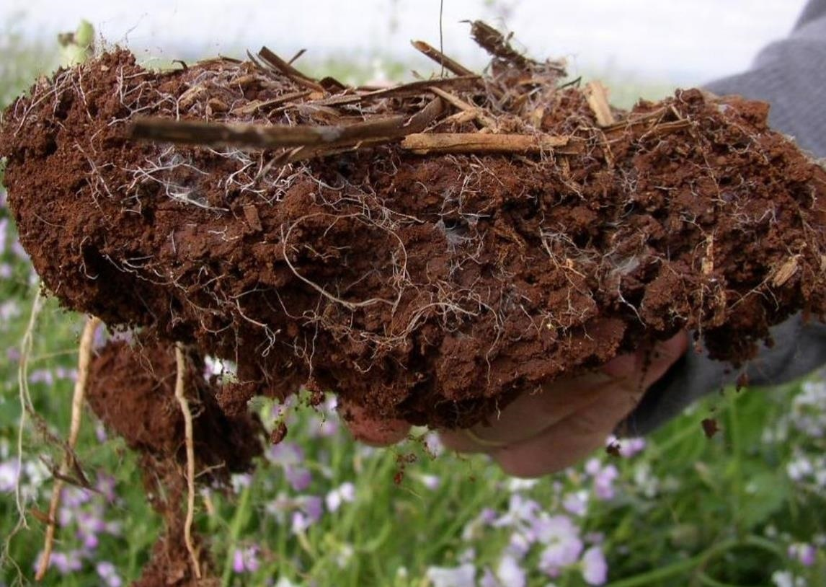
Biological Hot Spots
Litter layer
Earthworm & Root channels
Pore spaces
Root zone (rhizosphere)
Aggregate surfaces
Photo: Dr. Joao Carlos De Moraes Sa
Notes:
Despite the fact that most microbes are in a resting phase, there are biological hot spots where population size and activity are orders of magnitude higher relative to the bulk soil. A highly functioning soil will support all of these ‘hot spots’ sometimes referred to as spheres of influence. These hot spots include the area immediately surrounding plant roots aka the rhizosphere where soil microbes are stimulated by the release of sugars from plant roots as an output of photosynthesis. As plants produce aboveground biomass and die, their residues will form a litter layer. As these residues are decomposed, earthworm activity and root channels support increased biological activity and aid in the formation of macropores and strong stable aggregates. These hot spots support multiple biological processes that are working in concert together. If we can select management systems to optimize and maximize these hot spot zones in soil, soil biological function is enhanced which will result in more efficient and resilient systems. The following slides will run through each of these independently.
This information is taken for a paper entitled A hierarchical approach to evaluating the significance of soil biodiversity to biogeochemical cycling by M.H. Beare and others, below are some direct quotations
Soils can viewed as being composed of a number of biologically relevant spheres of influence that define much of their spatial and temporal heterogeneity.
They are formed and maintained by biological influences that operate at different spatial and temporal scales. Although not mutually exclusive, each sphere has fairly distinct properties that regulate the interactions among organisms and the biogeochemical processes that they mediate.
A hierarchical view of biodiversity as it influences the diversity in structure and function of ecosystems.
Illustrates the places that microbes live—if any are missing then soil health is degraded.
To begin to understand how to evaluate the health of a soil from a biological perspective, we need to change our view on how soil functions. One approach is to take a hierarchical view of the biological hot spots in soil. A highly functioning soil will support all of these ‘hot spots’ sometimes referred to as spheres of influence. These hot spots support multiple biological processes that are working in concert together. The following slides will run through each of these independently.
This information is taken for a paper entitled A hierarchical approach to evaluating the significance of soil biodiversity to biogeochemical cycling by M.H. Beare and others, below are some direct quotations
Soils can viewed as being composed of a number of biologically relevant spheres of influence that define much of their spatial and temporal heterogeneity.
They are formed and maintained by biological influences that operate at different spatial and temporal scales. Although not mutually exclusive, each sphere has fairly distinct properties that regulate the interactions among organisms and the biogeochemical processes that they mediate.
Probably more than any other biological factor, the composition and structure of plant communities determine, directly or indirectly, the physical, chemical and biological properties of soils. Individual plants can have markedly different zones of influence in soils.
Stress that when conditions are not conducive to meso macro fauna growth that these hotspots can be indicators for the soil organism habitat RC, if the habitat is there then the possibility of soil animals is as well, also dependent upon Disturbance: chem; physical; biological.
Beare, M.H., Coleman, D.C., Crossley, D.A., Hendrix, P.F., Odum, E.P., 1995. A hierarchical approach to evaluating the significance of soil biodiversity to biogeochemical cycling. Plant and Soil 170, 5e22
Kuzyakov, Y and E. Blagodatskaya. 2015. Microbial hotspots and hot moments in soil: Concept & review. Soil Biology and Biochemistry. Vol. 83, pp. 184-199. http://dx.doi.org/10.1016/j.soilbio.2015.01.025

Slide 17
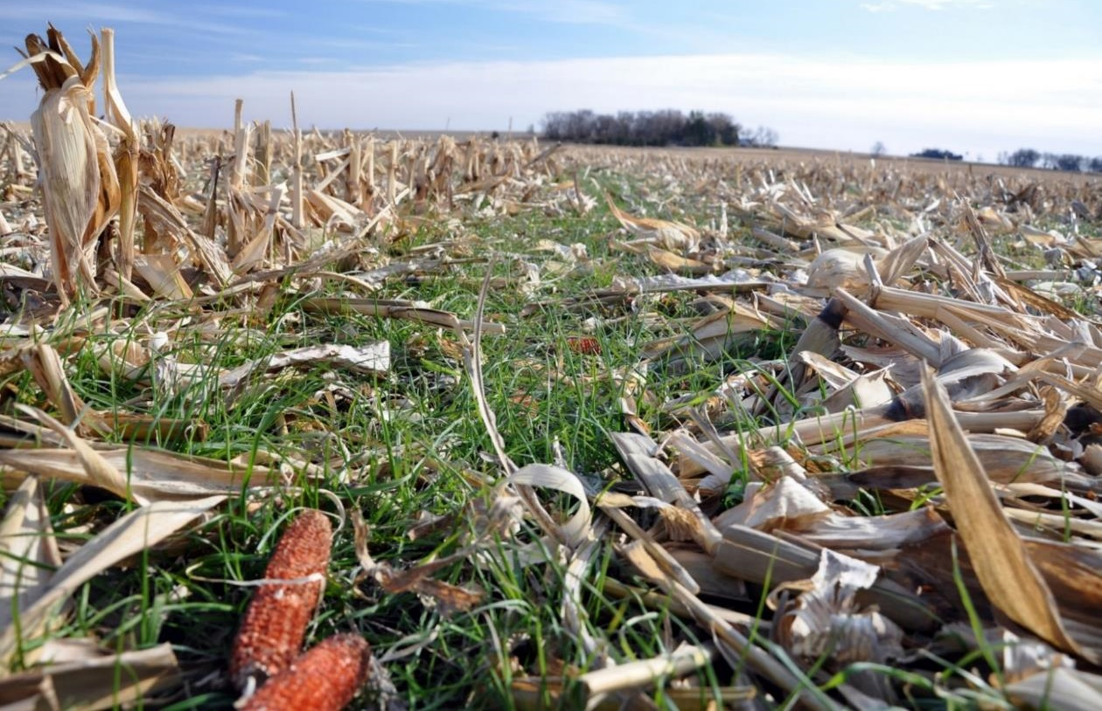

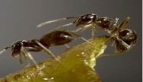
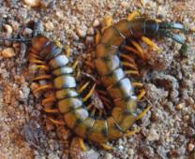
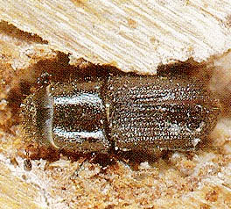
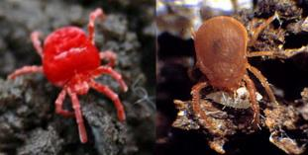
Hot Spot for Ecosystem Engineers:
Litter Layer
Protects soil
Conserves soil temp & moisture
Carbon source for soil organisms
  Turbe et al 2010; Orgiazzi, Bardgett, Barrios et al. 2016. Global Soil Biodiversity Atlas.
Notes:
Zone above mineral soil surface
Recognizable plant and animal detritus undergoing decay
High concentrations of saprophytic fungi, mites, nematodes and some macrofauna (e.g., beetles, centipedes, etc.)
Springtails and mites are tiny arthropods that eat bacteria and fungi associated with decaying vegetation.
The macrofauna help to shred, mix, and fragment residues at the surface. Increases surface area for saprophytic fungi and bacteria to release specialized enzymes that breakdown residues. Disperse microbial spores and influence microbial activity and nutrient cycles.
Photo ID from top down: earthworm, ant, centipede, sow bug (isopod), beetle, last two are mites or acari

Slide 18
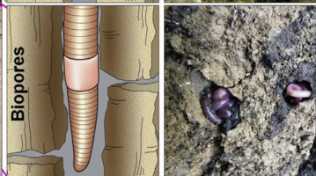
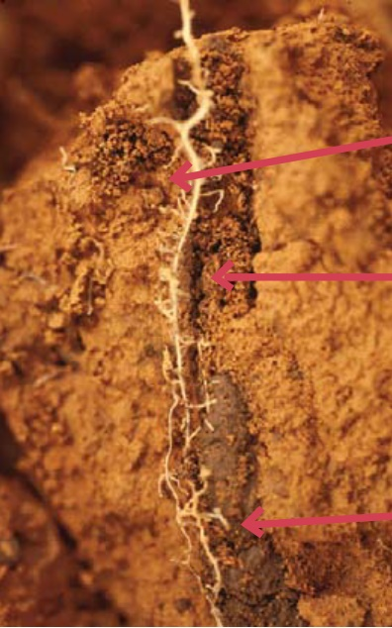
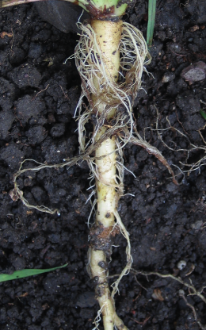
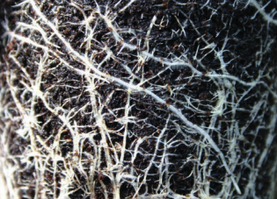
Hot Spot for Ecosystem Engineers
Earthworm and Root Channels
Mixes and moves residues
Large pores
Nutrient rich
Microbially enriched
Air and water flow
Roots grow & take advantage
P. Lavelle
Beare et al. 1995. Plant & Soil 170:5-22; Kuzyakov et al. 2015. Soil Biol Biochem 83:184-199
Notes:
input of labile and recalcitrant organics passed through and processed within the hindgut of earthworms (drilosphere) and other soil organisms (mainly invertebrates) at various depths
Redistributes plant litter “Carbon” throughout the soil the profile
Soils are enriched with N,P, and organic matter
Increase water infiltration
Provide a biopore for plant roots
Homogenize soil surface
Increase bio-diversity in soils

Slide 19
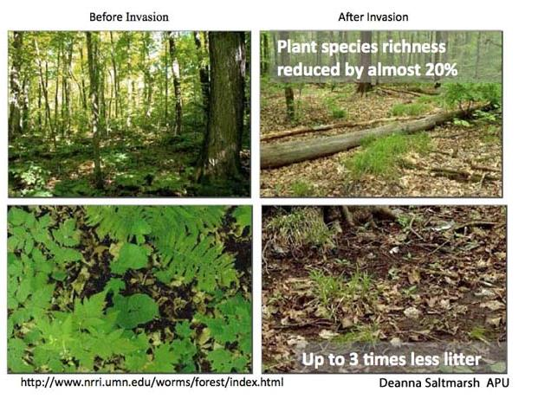
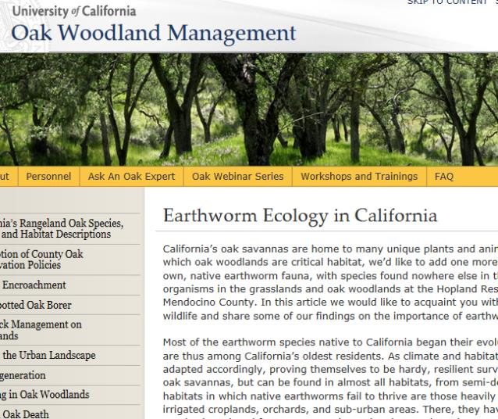
Not all Earthworms are Beneficial
...but some earthworms tend to be active at the soil surface for a longer period of time throughout the year. Thus, their net effect on soil fertility may be greater overall.
In pastures, fertilization and the planting of high-quality forage will increase earthworm densities, but possibly at the expense of native plants and animals, including native earthworms.
http://ucanr.edu/sites/oak_range/Oak_Articles_On_Line/Oak_Woodland_Ecology_and_Monitoring/Earthworm_Ecology_in_California/
Notes:
Optional SLIDE for area that have issues
They remove or bury a lot of surface residues that would otherwise protect soil surfaces from erosion, in forest floors they increase the amount of bulk density due to the weight of the casts and the consumption of forest leaf litter, they disperse weed seeds from place to place and can transmit disease from one place to another along with movement of soil biology that is pathogenic. IF in excess numbers they can increase the loss of N from leaching and denitrification and increased soil carbon loss through enhanced microbial respiration.

Slide 20
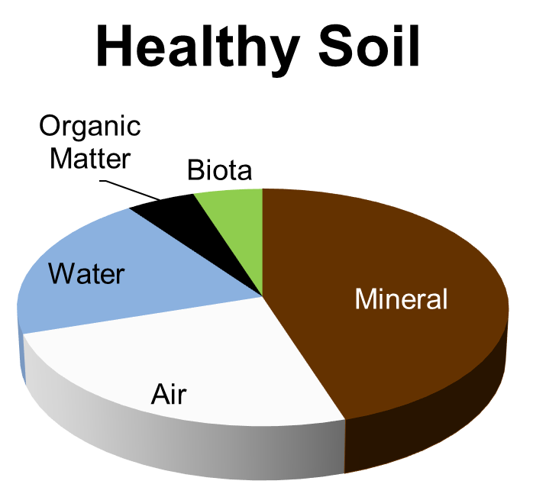
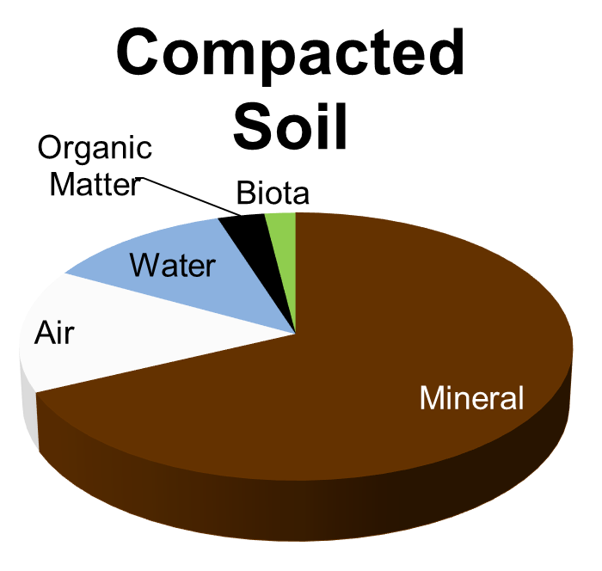
Hot Spots for Chemical Engineers & Regulators in Pore Spaces
Created via roots, organisms & SH management
“Lungs & circulatory system”
Air flow
Water flow, storage, & availability
Biological highways
Notes:
A healthy soil tends to have close to half of it’s volume occupied by space. This space is critical and serves as the ‘lungs and circulatory system of the soil’. In this zone, air and water flow are regulated, nutrients are cycled and transported in soil water, site of mycorrhizal entanglement and sequestration of water and nutrients, and can serve as biological highways as many soil organisms can only move through water and water films. Other smaller organisms can hitch rides on more mobile organisms or fungal hyphae which tend to be prevalent in the pore space.
Plant roots, earthworms and other arthropods can rearrange soil particles to create smooth, cylindrically shaped macropores (biopores)
Biopores can extend considerable distance in the soil forming channels for preferential flow of water and nutrients
Good air exchange in the soil creates habitat in which aerobic organisms can thrive
Poor air exchange leads to anaerobic conditions, organisms that can tolerate this habitat tend to be those that cause disease and produce byproducts that inhibit root growth, e.g. alcohols
Mix of different sized pores important
Collapse of space and large pores disrupts air, water, nutrient flows, and biological highways

Slide 21
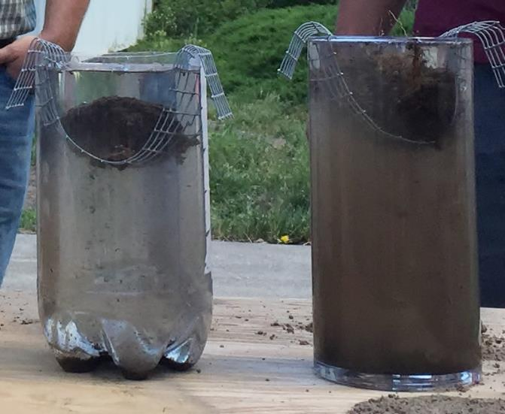
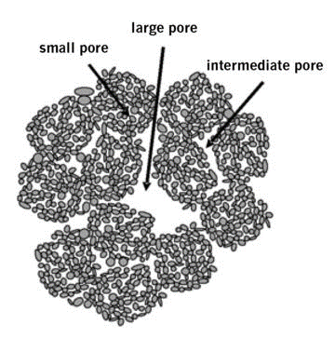
Aggregate Surfaces and Pore Space
Built with mineral, soil biology and organic materials
Creates stability and
resists erosion
Protects organic matter
and microbes
Physically supports pore spaces
Created by microbial glues, fungal hyphae, dead cells, plant roots and Earth worms
J Moore Kucera
USDA-SARE
Notes:
Mention that aggregates are the arrangement of not only mineral particles but also organic matter too! So that organic matter is, by definition, part of this hot spot!
Lack of good soil aggregation results in compacted soils that:
Restrict root growth
Provide poor root zone aeration
Have poor drainage
Soil compaction has always been thought of as a physical soil problem caused by excessive tillage and heavy equipment squeezing the soil pore space.
Compaction is actually a result of lose of soil organic matter and destruction of soil aggregates. These need to be replaced in the soil in order to provide a stable soil base in which to produce food & fiber
Soil compaction is a biological problem related to decreased production of polysaccharides and glycolproteins in the soil.
Soil compaction is due to a lack of living roots and mycorrhizal fungus in the soil.

Slide 22
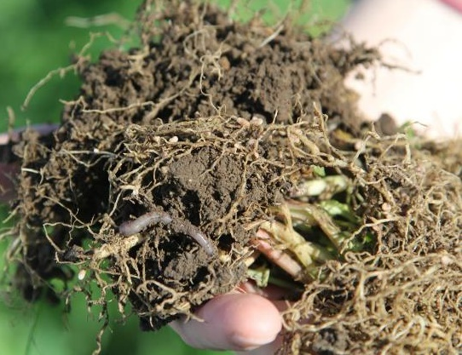
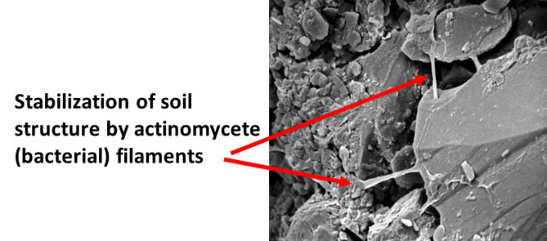
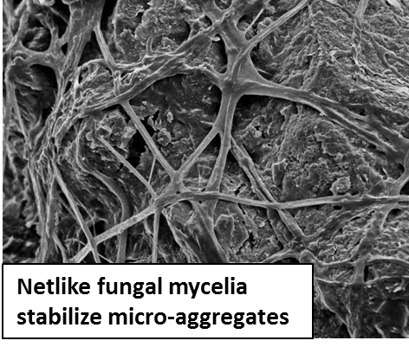
Soil Organisms Physically Form & Stabilize Soil Aggregates
Plant roots enmesh soil particles
Earthworm casts
Fungal and bacterial filaments physically enmesh soil particles
Roth, NRCS
SEM photo source (accessed on 6/2/2016): Eickhorst, Thilo & Tippkoetter, Rolf. Micropedology – The hidden world of soils. University of Bremen, Germany. http://www.microped.uni-bremen.de
Notes:
Plant roots not only enmesh aggregates, they physically move soil particles (like ants, termites, and earthworms) to initiate building aggregates.

Slide 23
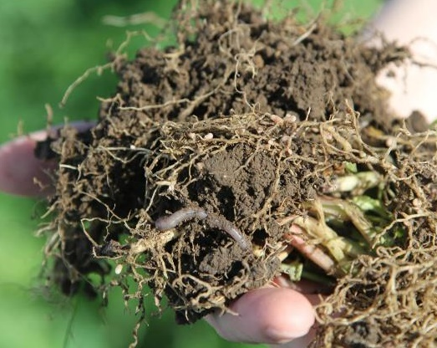
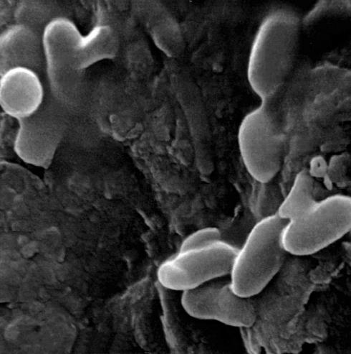
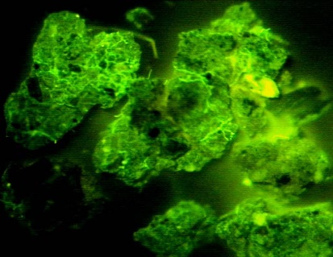
Soil Organisms Chemically Stabilize Soil Aggregates
Polysaccharides released by bacteria bind particles
Soil proteins and other biochemicals bind soil particles
Image source: Aaron Roth, NRCS-OR
Bacteria (ovals) with ‘sticky’ polysaccharides (red arrows)
Glycoproteins on soil aggregates
Nichols, USDA-ARS
SEM photo source: Eickhorst, Thilo & Tippkoetter, Rolf. Micropedology – The hidden world of soils. University of Bremen, Germany. http://www.microped.uni-bremen.de
Notes:
Tillage tends to reduce overall numbers of soil organisms, especially fungi that form hyphae and earthworms, important for soil aggregation and other soil functions. It also tends to favor increased bacterial populations and their predators (Protists and nematodes shift to bacterial-feeders). In contrast, no-till or reduced till favors higher overall populations, especially fungi and earthworms and nematodes shift to fungal-feeders.
Forming soil aggregates requires both a biological and physical actions
Need conditions that will allow for Arbuscular mycorrhizal fungi colonies to be established
AMF release glues as hyphae work their way out through the soil
Hyphae entangle soil particles, realign them
Create alternating wetting/drying cycles helping to bind particles together

Slide 24
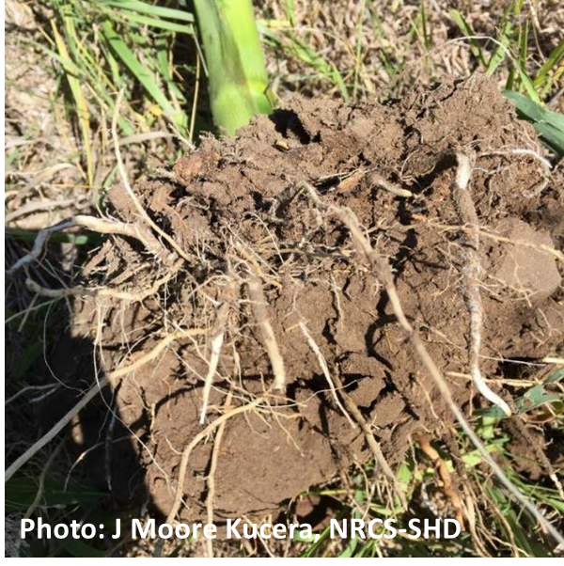
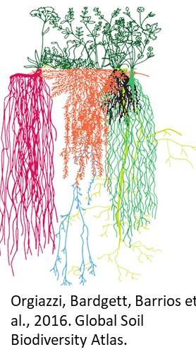
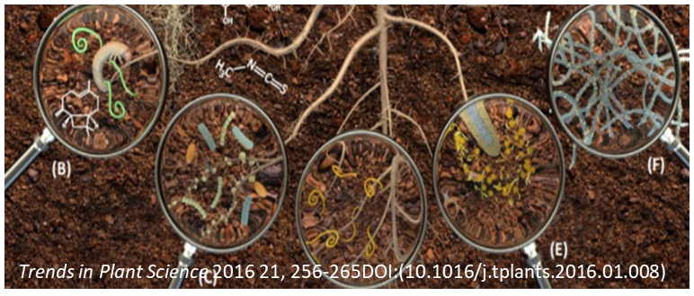
Hot Spot For Chemical Processors & Biological Regulators - Rhizosphere
Root exudates & chemical signals stimulates microbes & predators
  Symbiosis
  Protection
  Chemical signaling
  Nutrients
  Resilience
Notes:
highest density is in the A horizon but can occur throughout profile
Anchor
keeps plant in soil
prevents soil erosion
holds stem upright
Absorption
water
dissolved minerals
Storage
starch
other nutrients
Habitat
provides nutrients to microbes
Helps with aggregation

Slide 25
Root Zone (Rhizosphere):
Key Organisms
Bacteria
Most numerous
2-5% of SOM but responsible for 90% of energy flow
1 g can contain 10 million bacteria and one million species.
0.5-3 tons per acre
(Killham 1994)
Fungi
Saprophytic
Mycorrhizae
Pathogenic
Up to 5 tons per acre
Protozoa & Nematodes
*Consume microbes and
recycle nutrients to plant
roots
  Turbe et al 2010; Coleman & Crossley 1996; Nannipieri & Badalucco 2003; Global Soil Biodiversity Atlas. 2016. Orgiazzi, Bardgett, Barrios et al.
Notes:
The rhizosphere is an area of interaction between the surface of a plant root and the area surrounding it. Bacteria and other microorganisms as well as soil debris fill the area. 10,000x. Photograph by Sandra Silvers, USDA-ARS.
Lewis, Wayne; Lowenfels, Jeff. Teaming with Microbes: The Organic Gardener's Guide to the Soil Food Web, Revised Edition (Kindle Locations 183-184). Timber Press. Kindle Edition.
Different plants attract and support a different microbial community. Additional factors influencing biodiversity composition include composition of plant components, nutrient content in tissues, tissue senescence and temperature, moisture, and inherent soil properties.
1 g can contain 10 or more nematodes!
One acre may contain 200 pounds of nematodes!
1 g can contain 10,000+ protists!
One acre may the equivalent in weight of 2 sheep of protists!
Look at nematode assays
Are all players bad?
In conventional tillage systems, the microbial diversity is reduced due to changing environmental conditions. Conventional tillage systems have more bacteria and protozoa (especially cilates) because these organisms can tolerate compacted soils, anaerobic conditions, and reduced pore space. Larger fauna like nematodes, mycorrhizae fungi, and flagellates protozoa need larger pore space, aerobic soils, undisturbed soils and the right habitat (carbon residue) to flourish. When a no-till or cover crop system is re-introduced, bacteria levels do not decline but fungi, nematodes, and larger protozoa (flagellates, amoebid, and sporozoan species) will repopulate the soil, increasing soil microbial diversity, creating a more balanced system.
Smith .C.R. et al. 2016, Microbial community responses to soil tillage and crop rotation in a corn/soybean agroecosystem
Ecol Evol. 2016 Nov; 6(22): 8075–8084.
Published online 2016 Oct 14. doi: 10.1002/ece3.2553
Metarhizium fungi complement mycorrhizae fungi in the soil. Metarhizium fungi encompass about 13 known species and prefer undisturbed soils with actively growing plants. Metarhizium fungi are a parasite to over 200 insect species. The Metarhizium spores attach to insect eggs, larva, and adults; desiccating and mummifying its hosts. The spores germinate and form hyphae that attach to plant roots and are known to enhance nitrogen uptake in plant roots. Metarhizium fungi are used commercially because they contain an enzyme used to convert soybeans into soybean diesel.
https://en.wikipedia.org/wiki/Metarhizium_anisopliae
Dr. Mary Barbercheck, Cornell University, 2018

Slide 26
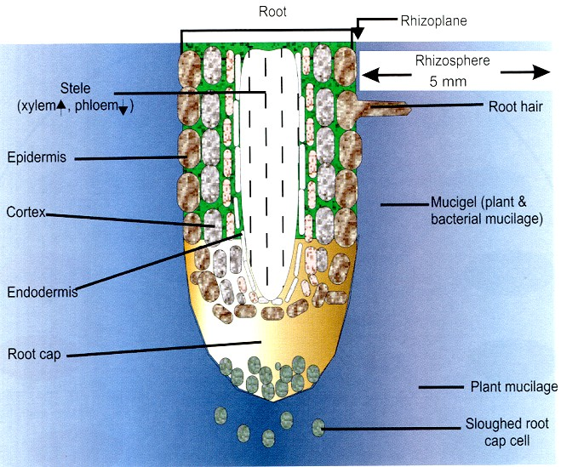
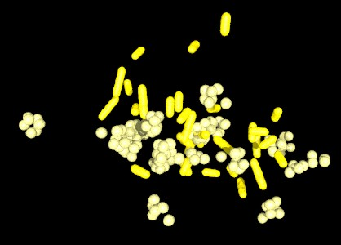
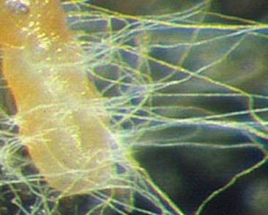


Plant Roots Attract Microbes
Exudates: carbohydrates and proteins secreted by roots; attract bacteria which nematodes & protozoa
consume, which mineralize nutrients for plants.
Bacteria and fungi are like little fertilizer bags
Nematodes and protozoa consume microbes and excrete plant available nutrients
Notes:
Microbes using soil carbon help cycle nitrogen and phosphorus because Plants Roots provide at least 20% of their CH2O to the soil where they attract soil habitats to the rhizosphere.
In real world bacteria growth limited by predators, water & food availability.
Photos:
Bashir, Owais & Khan, Kamran & Hakeem, Khalid & Mir, Naseer & Rather, Hassan & Mohiuddin, Rehana. (2016). Soil Microbe Diversity and Root Exudates as Important Aspects of Rhizosphere Ecosystem. 10.1007/978-3-319-29573-2_15.
New South Wales Department of Primary Industries, 2013
Department of Environment, Land, Water and Planning (DELWP), Victoria

Slide 27

Rhizosphere Key Organisms
Mycorrhizae
Mykós (fungus)- riza (root)
Plants use 5-20% of C from photosynthesis to ‘feed’ fungi
Fungi increase root surface area at least 10x
Fungi increase nutrient uptake especially P and Zn
Fungi suppress pests and diseases
Fungal networks build soil aggregates
USDA-SARE
Notes:
Greek word meaning fungus root
Brassicas are an example family that are non-mycorrhizal.
However, most crops are mycorrhizal including (read some…): Onions, corn, cotton, wheat, soybeans, potatoes, alfalfa, sugarcane, cassava, rice, most vegetables, beets, apples, grapes, citrus fruit, trees (lumber and fiber), cacao, coffee, rubber.
Some non-mycorrhizal crops have been shown to inhibit mycorrhizae in the next crops according to researchers at Penn State. These include canola, buckwheat, forage radish, camelina, and mustards. More research is needed to identify the impact of these crops when used with diverse mixtures (JMK’s opinion).
http://extension.psu.edu/plants/crops/cropping-systems/documents/mycorrhizal-fungi-and-field-crops.pdf
(see david Sylvia’s web page for C fluxes https://sites.psu.edu/dmsylviaweb/mycorrhiza-overview/ )

Slide 28


N-Fixing Bacteria (Rhizosphere)
Bradyhizobium Japonicum
for Soybean & Cowpea
Rhizobum trifolii
for most Clovers
Photo: Getty Images
Photo: Science Source
Notes:
The nitrogen cycle, propelled in part by specialized bacteria, is one of the most important systems in the maintenance of terrestrial life: living organisms produce the vital organic compounds, the building blocks of life— amino and nucleic acids— using nitrogen.
The strong bonds holding atmospheric nitrogen (N2) molecules together make this nitrogen inert for all practicable purposes and useless for plant needs. For plants to be able to use nitrogen, it has to be “fixed”— combined with either oxygen or hydrogen— producing ammonium (NH4 +), nitrate (NO3-), or nitrite (NO2-) ions.
This important process is called nitrogen fixation. Certain bacteria convert nitrogen from the atmosphere into plant-available forms. The genera that accomplish this nitrogen-fixing feat are Azotobacter, Azospirillum, Clostridium, and Rhizobium (any one of which would be a great name for a comic book superhero). Azotobacter, Azospirillum, and Clostridium live free in the soil; Rhizobium species actually live in the root tissues of certain plants, particularly legumes, where they form visible nodules. We don’t mean to suggest you need to memorize the species of soil bacteria, but we do want you to focus on the fact that nitrogen fixation as well as the recycling of carbon and sulfur requires the interventions of living organisms.
These are always taught as chemical processes, but they are really biological. Bacteria carry out these processes in the soil, forming symbiotic relationships with specific plants or existing symbiotically within organisms. Sounds like a case of the biology creating the chemistry for us.
Lewis, Wayne; Lowenfels, Jeff. Teaming with Microbes: The Organic Gardener's Guide to the Soil Food Web, Revised Edition (Kindle Locations 629-642). Timber Press. Kindle Edition.

Slide 29

Biology and the Phosphorus Cycle
Notes:
Be sure to add that soil biology as in slide before plays a great role in liberating soil phosphorus that is tied to colloids, they have enzymes that break bonds that hold P unavailable.
Video Credit: https://www.youtube.com/@knowthescience3905

Slide 30

Biology and the Phosphorus Cycle:
What factors affect P movement/availability?
Top: Global Soil Biodiversity Atlas, p.105: Simplified phosphorus (P) cycle in the soil. The regulation of soil P cycling is influenced by microorganisms (e.g. bacteria and fungi). (DG, JRC)
Notes:
P sources mainly from ancient rocks and deposits
Soil pH and minerals affect availability
Plant-microbe interactions release stored org-P and mineral-P
In acid soils Phophorus becomes unavailable and is tied to aluminum and iron, with higher pH phosphorus binds with calcium which is why it is critical to manage for the biological hotspots and use the principles to help make this phosphorus that is tied up more available. A soil test will only show that soil test level that is available not what is ties up to soil colloids.

Slide 31

Biology and Nitrogen Cycle
Notes:
You will need to have internet to watch this video. this video takes approximately 5 minutes to watch.
Video credit: https://www.youtube.com/@JimiSol

Slide 32

Biology and the Nitrogen Cycle
Notes:
This is to be used in place of the previous slide. If you do not have internet use this slide
The nitrogen cycle in a soil-plant system. One potential pathway: N is fixed by microbes into organic compounds, which are mineralized (i.e. ammonification) and then oxidized to inorganic forms (i.e. nitrification) that are assimilated by plants (NH4+)ammonium and nitrate (NO₃⁻). NO₃⁻ may also be denitrified by bacteria, producing N₂, NO_{x}, and N₂O.
Created: 27 September 2009
Image by Johann Dréo

Slide 33
Knowledge Check - Poll Question
How many types of biological hotspots are there in the soil ecosystem?

Slide 34
How Can the Soil Microbiome be Manipulated?
Select different plant species, varieties, or control at various plant stages (e.g., crop rotation, cover crop selection, planting timing and termination)
Fertilization (4 R’s)
Soil amendments, including biologicals (promise but fraught with issues)
Manage the environment to minimize stress (e.g., pathogens, drought, temperature extremes, etc.)
  Temperature
  Moisture
  Maximize presence and duration of hot spots
Notes:
****Include if you add materials that suppress certain organisms or if you add certain organisms, it could potentially lead to an IMBALANCE in the system! Don’t do things as an insurance practice but with purpose. By knocking out one threat, you might be creating a new threat. Link again when you bring up managing the system…
Different plant species, varieties, and plant growth stage select for different microbial populations.
Fertilization impacts root exudation composition and quantity and influences which microbes are present and how many.
Stress induction: stressed plants select for microbes to help deal with environmental stressors (e.g., drought) and pathogens.
Soil amendments have been used to stimulate beneficial microbes to defend against plant diseases and pathogens.
Soil ‘biologicals’ or biological amendments have promise but consistency and quality remain an issue for the industry.

Slide 35







Belowground Competition
Nematode-trapping Fungi
Protection from Rhizoctonia solani
Mite preying on a nematode
Roots with springtails
Roots without springtails
A single protozoan can eat billions of bacteria each day!
Soybean cyst nematode parasitized by the fungus Hirsutella minnesotensis
Vampyrellids (protist) eating a fungal root pathogen involved in take-all disease
Notes:
Wehen we have good diversity of microbial communities we can impact disease and insect infestations, as soil biology can prey on diseases and insects.
http://www.extension.umn.edu/agriculture/soybean/soybean-cyst-nematode/chemical-biological-potential.html

Slide 36
Summary:
Managing for Soil Biology
Conventional
Soil Health Management System
Most ag soils are carbon depleted
Disturbances destroys habitat and hyphal networks
Bare, fallow fields provide little protection, no C
Agrichemicals have mixed effects
Many fertilizer concentrations too high for symbiosis
Manage for hot spots
Support biology to build aggregates and create pore space
Protect the habitat
Feed the soil so it can feed us
Optimize biological nutrient cycling
Optimize plant-microbe interactions for plant defense optimization
Notes:
Blue font is conventional/previous system – black font is a soil health management system.
Stress that the blue systems is what we have been traditionally been seeing and doing. To improve soil health we need to do what is written in black.

Slide 37













Biological Hot Spots to
Optimize Function
Photo source: NRCS
Photo source: P. Lavelle;
J Moore-Kucera
Photo source: J Moore-Kucera
Photo source: Barry Fisher, NRCS
Root cartoon and organism images: Orgiazzi , Bardgett, Barrios et al. 2016. Global Soil Biodiversity Atlas.; Slide design by J Moore-Kucera
Notes:
There are multiple biological hotspots found in soil and they are all interrelated. These hotspots will be how your planners will determine if there is a biological component in the indicators in CART.
However, probably the most important hot spot is the rhizosphere, this is the area immediately surrounding plant roots. During photosynthesis, plants pull CO2 out of the atmosphere and convert it into carbohydrates and build biomass above and belowground. 20% or more of this C fixed by plants is released out of the roots in compounds called root exudates. This is not a leaky system but rather has evolved over time to stimulate the microbial community that comes in for the feast. The bacteria and fungi taking up these compounds in return aid the plant

Slide 38

What do Soil Organisms Need?
How can we feed belowground life?
  Choose practices that provide diverse, near continuous inputs and build reserves (SOM)
How can we provide & protect habitat?
  Choose practices that minimize disturbance of habitat (aggregates) and food sources (SOM + residue)
  Choose practices that support a stable habitat from major swings in temperature, water, & chemistry
Remsberg, SARE
Notes:
The next module will go into greater detail about these principles and identify specific practices to support, maintain, and enhance soil biology and the critical functions they perform.
Food
Habitat
Water
Oxygen*

Slide 39



Soil Health Principles
Protect Soil Aggregates & Organic Matter
Feed & Fuel Soil Biology
Nutrient/ H₂O Mgt
*Modified from USDA –NRCS-Principles for High Functioning Soils Factsheet
Notes:
The NRCS proposes basic principles of managing for soil health. These are:
And can be distilled down to two broad categories
Feed diverse, continuous inputs (C sources, energy)
Protect habitat (aggregates and organic matter)
Maintain SOM & aggregates; Reduce erosion & runoff risk
Buffer temperature; Reduce evaporation
Feed: Break disease cycles; Stimulate microbial diversity; Increase SOM and nutrient cycling
Enhance plant growth; Increase predator & pollinator populations

Slide 40

This information is provided as a public service and constitutes no endorsement by the United States Department of Agriculture or the Natural Resources Conservation Service of any service, supply, or equipment listed.
While an effort has been made to provide a complete and accurate listing of services, supplies, and equipment, omissions or other errors may occur and, therefore, other available sources of information should be consulted
The USDA is an equal opportunity provider and employer.
Meeh, NRCS

Slide 41
Knowledge Check – Poll Question
Are Mycorrhizal Fungi beneficial to plants?

